Slide 1
LitterBoard

Slide 2
Mission
Our mission is to clean up the streets of our neighborhoods
Encenticize people to clean up
Use technology to help the environment

Slide 3


Slide 4
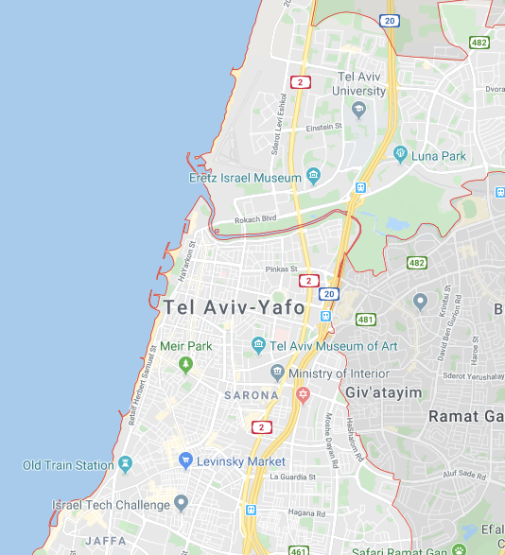
location
Our events occur in Tel Aviv neighborhoods:
Gordon Beach
Florentin
Old North
Shuk ha Carmel
Jaffa
Marina
Sarona Market

Slide 5
Events
Before:
After:

Slide 6
Swot – strengths, weaknesses, opportunities, threats

Slide 7
Why LitterBoard?
Help your community! have fun! win prizes!

